Slide 1

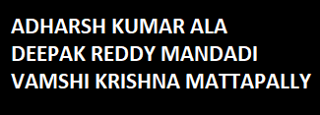

Slide 2

Introduction
Design Flow
Data Extraction
Data Ingestion – Kafka
Data Storage - MongoDB
Data Transformation - Spark
Data Visualization- Zeppelin

Slide 3

INTRODUCTION

Slide 4
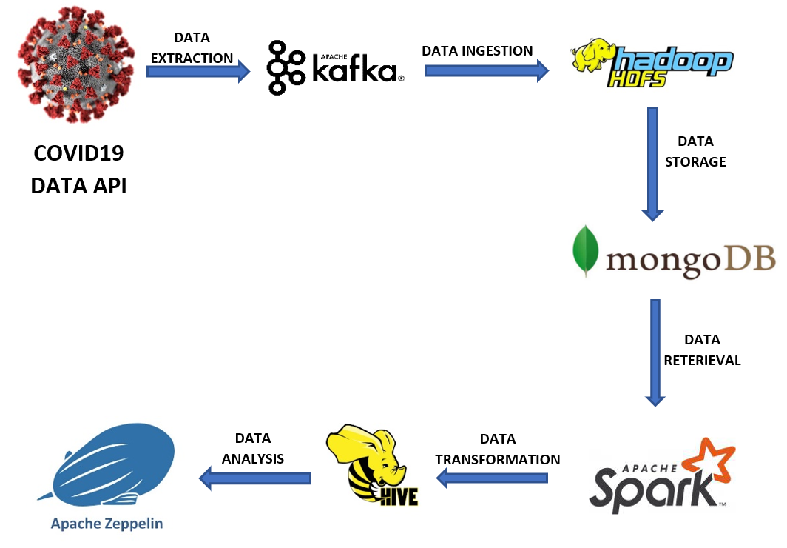
DESIGN FLOW

Slide 5
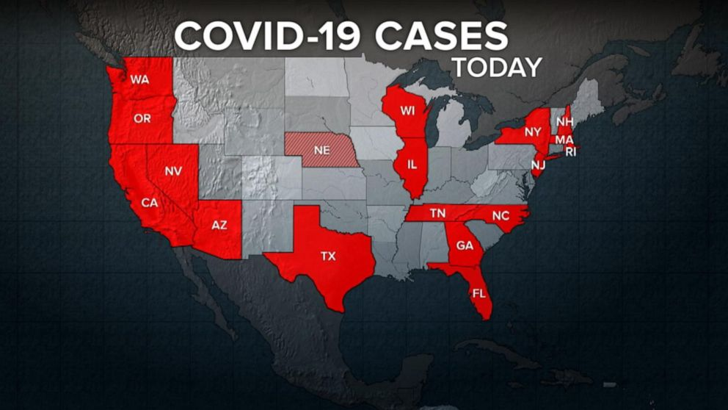
DATA EXTRACTION

Slide 6

OVERVIEW OF DATASET
COVID Tracking Project API
Real time data is available for US States and territories
Data is in json format.
Key Attributes includes positive cases count, negative cases count, hospitalized currently, pending cases count, death count are mentioned for each state.

Slide 7

DATA INGESTION

Slide 8
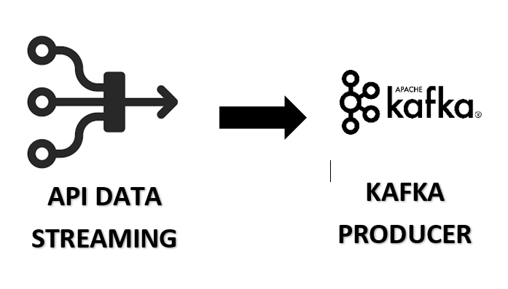
KAFKA PRODUCER
Kafka Producer is used to collect API data
Real time streaming data is stored in Kafka Topic.
Kafka Producer broker is set up on Hortonworks HDP Platform to collect data from API.

Slide 9
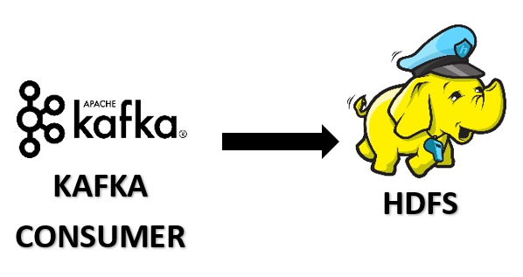
KAFKA CONSUMER
Data stored in kafka topic is consumed using Kafka Consumer Broker.
Consumed data is pushed to HDFS Storage.
Data is transformed to JSON Format output

Slide 10
DATA STORAGE

Slide 11

DATA STORAGE
Data is imported into Mongodb collection from HDFS.
Mongo-Spark connector is used to push data into Mongodb.

Slide 12


Slide 13

Spark-Hive Integration
Data from MongoDB is dumped into Hive Tables.
Transformations are applied on unstructured data.
Pyspark is used to enable Hive support and import data.
Hive Tables data is used for data analysis.

Slide 14

DATA VISUALIZATION

Slide 15

DATA VISUALIZATION - ZEPPELIN
Apache Zeppelin notebook on Hortonworks is used for data analysis
Statistical analysis is made from Hive tables using Spark
Visualization is achieved using Pyspark with Hive tables data.

Slide 16

STAY SAFE
Notes:
sdgsgsgsgs

Slide 17


